Slide 1
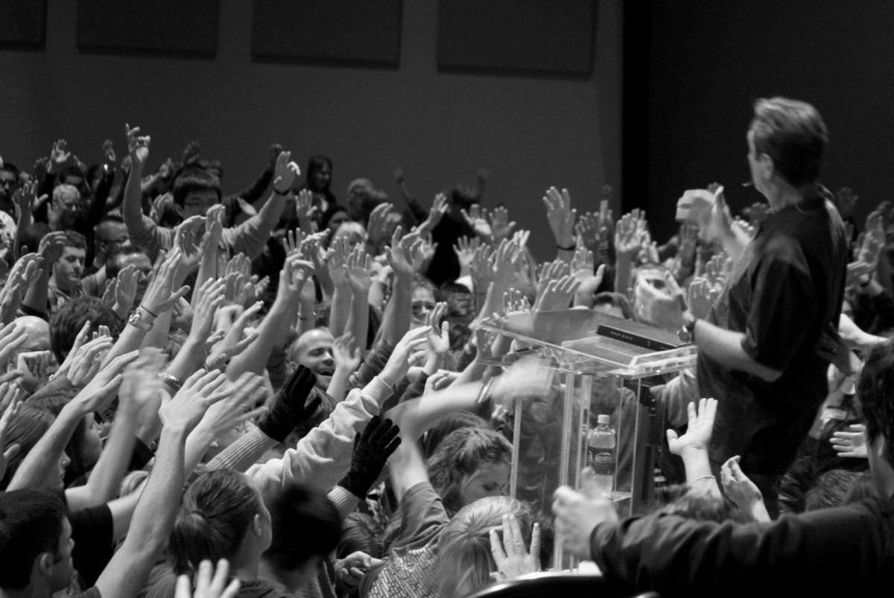
Be Protected
Colossians
Dr. Rick Griffith • Crossroads International Church Singapore
BibleStudyDownloads.org

Slide 2
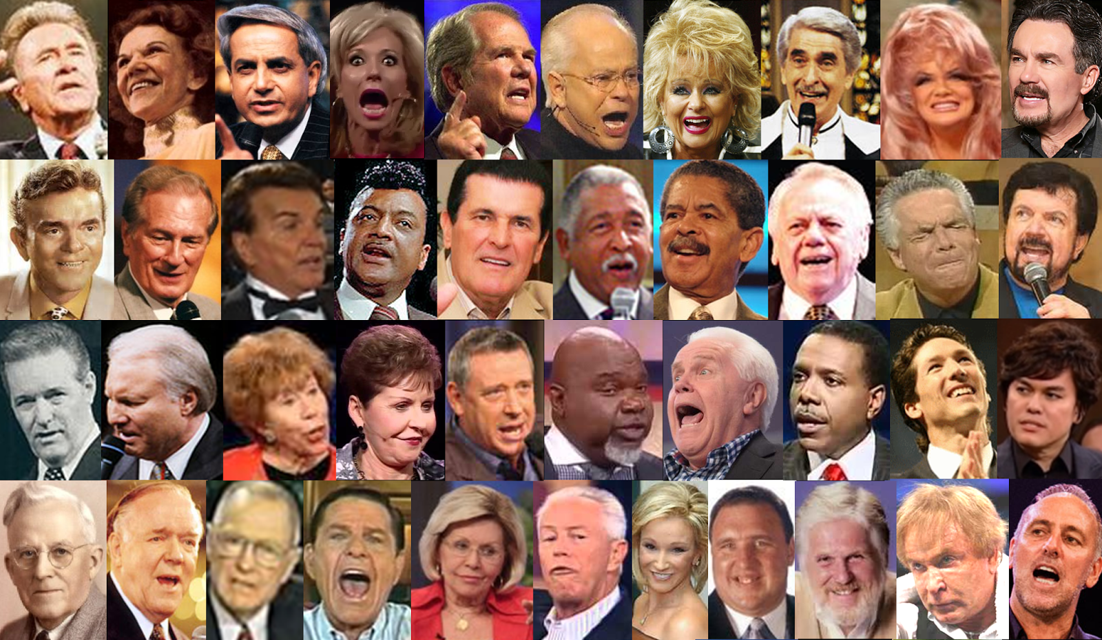
False Teachers Deny the Deity and Work of Christ
Colossians
Notes:
False teaching is all around us. Reputable survey organizations in the USA like Gallup and Barna report that many fall for false teaching so that they leave the church.

Slide 3
False Teaching
Notes:
This is especially true for teenagers. The influences on kids when they are young are seen only a few years later.

Slide 4
Foster Letter 2002
"The 'American Family In Crises Research' by the Southern Baptist Council on Family Life uncovered some disturbing facts. Of the children raised in evangelical homes, 88% leave the church at age 18 and never return."
Pastor's Weekly Briefing, Focus on the Family, 26 July 2002, quoted in Gary Foster, The Foster Letter, 10 Aug. 2002, p. 1.
Notes:
The studies I have seen show that between 65-88% of teens in the church will not attend church in their twenties.
________________
From Carl Kerby
Following is the entire quote that was in Terry Mortenson’s newsletter. My source was the 7/26/02 issue of Pastor's Weekly Briefing published by the Pastoral Ministries department of Focus on the Family.
American Family In Crises Research by the Southern Baptist Council on Family Life has uncovered some disturbing facts that are leading the group to emphasize the need to rebuild the American family.
§ 88% of the children raised in evangelical homes leave church at the age of 18, never to return.
§ The divorce ratio among members of evangelical churches is virtually the same as non-church members.
§ One million children in the U.S. see their parents divorce.
§ Personal bankruptcies are at an all-time high in America.
The majority of children in America have less than 10 minutes of significant and meaningful conversation with their parents each week. If you remove the mother, you can measure this statistic in seconds. The council recommends that families set aside one evening a week as a family night, on which no local church activities would be scheduled to interfere. It also urged an increased emphasis on biblically based premarital counseling. (PWB 7/26)
Gary D. Foster
Gary D. Foster Consulting
334 Sutherland Place
Manitou Springs, CO 80829
Phone: 719-685-1138 E-mail: GFosterCns@rmi.net Website: http://www.garydfoster.com/
"Helping Christian ministries & product companies discover new revenue streams and to better leverage existing ones."

Slide 5
Already Gone 04802
Already Gone
by Ken Ham and Britt Beemer, with Todd Hillard
© Answers in Genesis-USA
Notes:
Ken Ham & Britt Beemer note this in their 2009 book. That title means that young people are in our pews physically, but their values are already gone before their bodies are.

Slide 6
False Teaching
Notes:
But for those of us older, the temptations to false teaching are also real.
Have you even noticed how more enticing heresy is than truth? False teachers are more interesting than teachers of truth like me!

Slide 7
False Teaching
Notes:
There is an allurement for men where sex continues in the afterlife. That is Mormonism and Islam.
How cool to die and then go create your own planet and populate it with your harem—Mormonism again.
Most false teaching doesn’t get convicting with talk about sin—or make you feel bad.
I have a relative tell me that we can still live like we want and be “very spiritual.”

Slide 8
Be Protected
Notes:
Need: So what is your strategy to stay faithful to the Lord so you don’t fall prey to heresy?
What should you being doing to avoid false teaching?
How much should you study these groups?
How do you avoid becoming part of the statistics of those who abandon the Lord Jesus? Today we will answer this question…

Slide 9
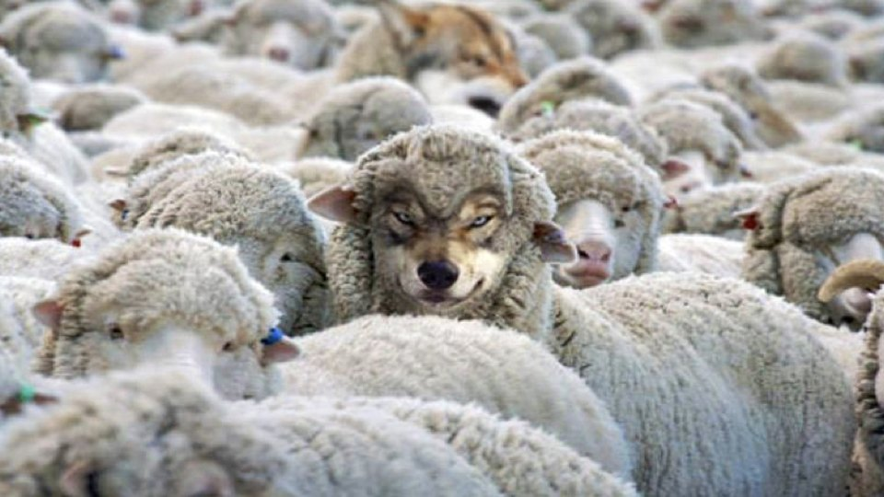
How can you be protected from false teaching?
Notes:
What ways can we prevent heretical ideas from capturing us in their snare?

Slide 10
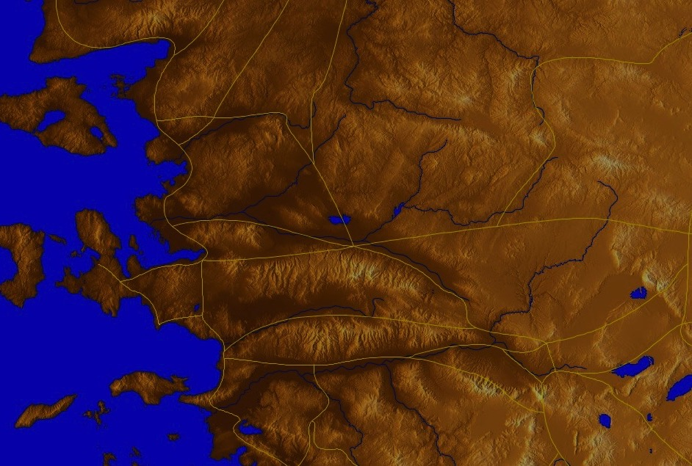
Colossae & The 7 Churches (Rev. 2–3)
Adramyttium
Aezani
Pergamum
Thyatira
Cyme
Erythrae
Sardis
Smyrna
Eumenia
Philadelphia
Lebedus
Colophon
Ephesus
Nysa
Laodicea
Hierapolis
Trailes
Heraclea
Aphrodisias
Colossae
Alabanda
Patmos
Miletus
Notes:
Colossians believers were being led astray.
__________
Jesus designed a brilliant strategy by having his revelation sent to capital of the province, Ephesus. It included an individual letter to Ephesus, as well as letters to 6 other key churches. The Ephesians copied the entire book of Revelation, though, and sent the original to the next city, Smyrna. Smyrna then made their own copy and sent the original to Pergamum, which lay on the main road to the north. This city then sent the prophecy to Thyatira, which sent it to Sardis, then Philadelphia, and finally to Laodicea.

Slide 11
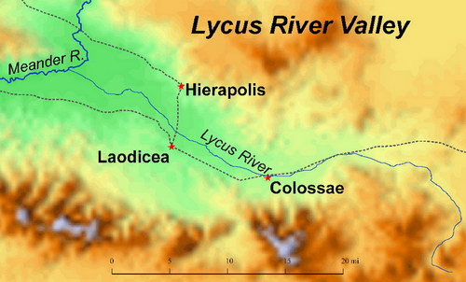
Lycus River Valley
Meander R.
Hierapolis
Hot springs
Lycus R.
Laodicea
Lukewarm
Colossae
Cold springs
Laodicea had money but no water
Notes:
The city of Colossae had cool water that was brought to nearby Laodicea.
Paul had never visited Colosse when he wrote this letter. However, during his nearly three-year ministry in nearby Ephesus (Sept 53-May 56; cf. Acts 19) he probably met (and may have converted) Epaphras, who returned to Colosse and founded the church (1:7). Five years later, when Epaphras heard of Paul's imprisonment, he visited the apostle and brought news of their love (1:8).

Slide 12
Occasion
188-189
Paul had never visited Colosse before he wrote this letter. However, during his nearly three year ministry in nearby Ephesus, he probably met (& may have converted) Epaphras, who likely went to Colosse and started the church.
Epaphras brought news of a serious heresy plaguing the church. This prompted Paul to pen the epistle to the Colossians for Tychicus to deliver since he was returning to Colosse with Onesimus.

Slide 13
Occasion
188-189
Asia Minor was the seedbed for what developed into 2nd century Gnosticism. Paul's counterattack tells us this about the heresy:
1. Jewish—legalism of following OT laws and ceremonies (2:16-17)
2. Greek philosophy—followed a so-called "deeper knowledge" revealed only to a special "elite" (2:2b-4, 8-10)
3. Worshipped angels as mediators between man and God (2:18)
4. Denied Christ's deity (1:15; 2:9), & thus His supremacy (1:15b, 17a) & ability to create (1:16) & sustain the world (1:17)
5. Ascetic nature had a low view of the body (2:20-23)
What was the Colossian heresy? The above shows it was a syncretistic Jewish-Greek-Ascetic-Pagan cult. Paul's method to fight the heresy is to emphasize the deity & supremacy of Christ.
Paul had never visited Colosse before he wrote this letter. However, during his nearly three year ministry in nearby Ephesus, he probably met (& may have converted) Epaphras, who likely went to Colosse and started the church.
Epaphras brought news of a serious heresy plaguing the church. This prompted Paul to pen the epistle to the Colossians for Tychicus to deliver since he was returning to Colosse with Onesimus.
Notes:
Epaphras evidently also told Paul of a serious heresy plaguing the church. This prompted Paul to pen the epistle to the Colossians for Tychicus to deliver since he was returning to Colosse with Onesimus anyway. The nature of the heresy has been much debated, but the internal evidence suggests that it was the seedbed for what later developed into Gnosticism in the second century.
Paul’s response reveals the many problems with this heresy. It was a syncretistic heresy with five basic elements. We see these five problems in Colossians 2:
Its Jewish nature showed in its legalism by imposing Old Testament laws and rituals (2:16-17).

Slide 14
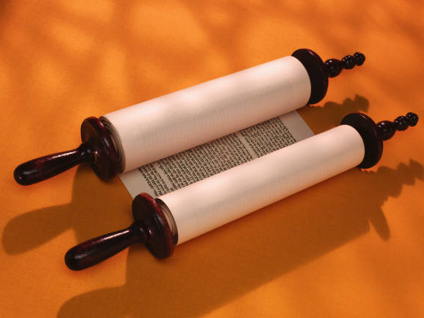
Jewish: The Law is Good
but…

Slide 15
No Legalism!
"So don't let anyone condemn you for what you eat or drink, or for not celebrating certain holy days or new moon ceremonies or Sabbaths. ¹⁷For these rules are only shadows of the reality yet to come. And Christ himself is that reality" (Col. 2:16-17 NLT)

Slide 16
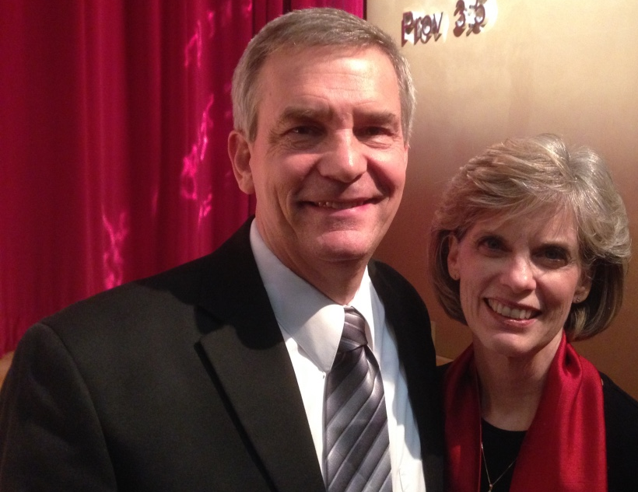
No Shadows!
"So don't let anyone condemn you for what you eat or drink, or for not celebrating certain holy days or new moon ceremonies or Sabbaths. ¹⁷For these rules are only shadows of the reality yet to come. And Christ himself is that reality" (2:16-17 NLT)
Notes:
What would you think if I looked at Susan’s shadow on my chest and said, “Wow, what a wonderful shadow! Look at the shape of that shadow! So nice, so perfect!”
You would think I am nuts. You would say, “Why are you so enamored with Susan’s shadow? You give more attention to your wife’s shadow than to this beautiful, dedicated, faithful woman herself standing next to you. What’s wrong with you?”
Too often Christians do the same with Jesus. We delight in the rest he gives us, we are enamored with the rules we have—and we neglect the very reality of Jesus himself!”

Slide 17
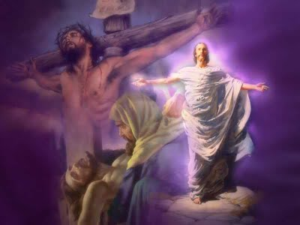
Focus on:
"And Christ himself is that reality" (2:17b NLT)
Death
Resurrection
Burial

Slide 18
Occasion
188-189
Asia Minor was the seedbed for what developed into 2nd century Gnosticism. Paul's counterattack tells us this about the heresy:
1. Jewish—legalism of following OT laws and ceremonies (2:16-17)
2. Greek philosophy—followed a so-called "deeper knowledge" revealed only to a special "elite" (2:2b-4, 8-10)
3. Worshipped angels as mediators between man and God (2:18)
4. Denied Christ's deity (1:15; 2:9), & thus His supremacy (1:15b, 17a) & ability to create (1:16) & sustain the world (1:17)
5. Ascetic nature had a low view of the body (2:20-23)
What was the Colossian heresy? The above shows it was a syncretistic Jewish-Greek-Ascetic-Pagan cult. Paul's method to fight the heresy is to emphasize the deity & supremacy of Christ.

Slide 19
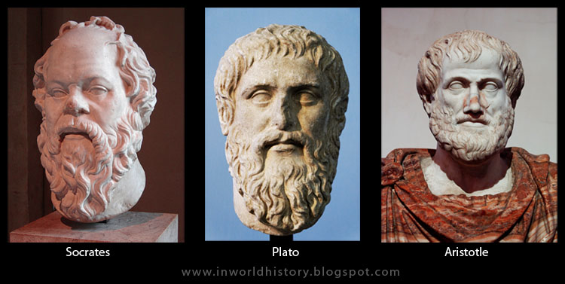
Greek Philosophy
Don't let anyone capture you with empty philosophies and high-sounding nonsense that come from human thinking and from the spiritual powers of this world, rather than from Christ (2:8 NLT)
"Good people do not need laws to tell them to act responsibly, while bad people will find a way around the laws"
—Plato
423-348 BC
Socrates
Plato
Aristotle

Slide 20
Key Verse
187
"For in Christ all the fullness of the Deity lives in bodily form"
(Colossians 2:9).
Colossians

Slide 21
Occasion
188-189
Asia Minor was the seedbed for what developed into 2nd century Gnosticism. Paul's counterattack tells us this about the heresy:
1. Jewish—legalism of following OT laws and ceremonies (2:16-17)
2. Greek philosophy—followed a so-called "deeper knowledge" revealed only to a special "elite" (2:2b-4, 8-10)
3. Worshipped angels as mediators between man and God (2:18)
4. Denied Christ's deity (1:15; 2:9), & thus His supremacy (1:15b, 17a) & ability to create (1:16) & sustain the world (1:17)
5. Ascetic nature had a low view of the body (2:20-23)
What was the Colossian heresy? The above shows it was a syncretistic Jewish-Greek-Ascetic-Pagan cult. Paul's method to fight the heresy is to emphasize the deity & supremacy of Christ.

Slide 22
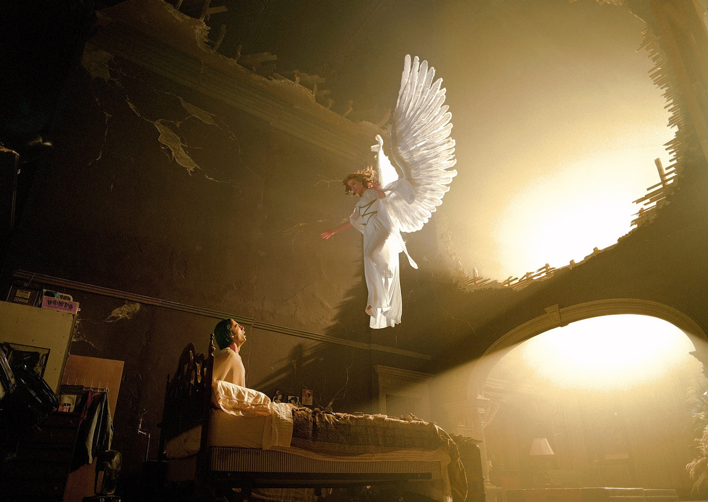
Angel Worship
"Don't let anyone condemn you by insisting on pious self-denial or the worship of angels…"
"…saying they have had visions about these things. Their sinful minds have made them proud" (2:18 NLT)

Slide 23
Messages from Angels?
Joyce Meyers believes and teaches…

Slide 24
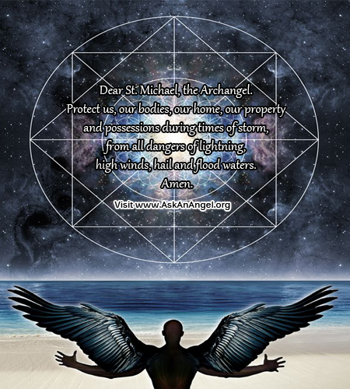
AskAnAngel.org
Dear St. Michael, the Archangel…

Slide 25
Occasion
188-189
Asia Minor was the seedbed for what developed into 2nd century Gnosticism. Paul's counterattack tells us this about the heresy:
1. Jewish—legalism of following OT laws and ceremonies (2:16-17)
2. Greek philosophy—followed a so-called "deeper knowledge" revealed only to a special "elite" (2:2b-4, 8-10)
3. Worshipped angels as mediators between man and God (2:18)
4. Denied Christ's deity (1:15; 2:9), & thus His supremacy (1:15b, 17a) & ability to create (1:16) & sustain the world (1:17)
5. Ascetic nature had a low view of the body (2:20-23)
What was the Colossian heresy? The above shows it was a syncretistic Jewish-Greek-Ascetic-Pagan cult. Paul's method to fight the heresy is to emphasize the deity & supremacy of Christ.

Slide 26
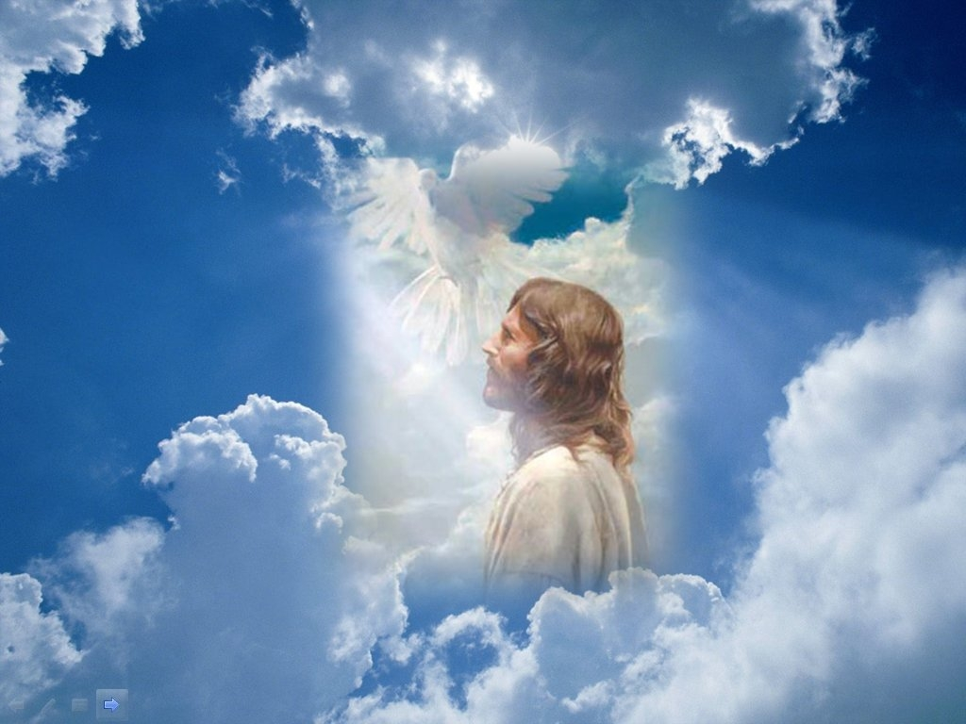
Christ's Deity
"Christ is the visible image of the invisible God. He existed before anything was created and is supreme over all creation" (1:15 NLT)

Slide 27
Occasion
188-189
Asia Minor was the seedbed for what developed into 2nd century Gnosticism. Paul's counterattack tells us this about the heresy:
1. Jewish—legalism of following OT laws and ceremonies (2:16-17)
2. Greek philosophy—followed a so-called "deeper knowledge" revealed only to a special "elite" (2:2b-4, 8-10)
3. Worshipped angels as mediators between man and God (2:18)
4. Denied Christ's deity (1:15; 2:9), & thus His supremacy (1:15b, 17a) & ability to create (1:16) & sustain the world (1:17)
5. Ascetic nature had a low view of the body (2:20-23)
What was the Colossian heresy? The above shows it was a syncretistic Jewish-Greek-Ascetic-Pagan cult. Paul's method to fight the heresy is to emphasize the deity & supremacy of Christ.

Slide 28
Asceticism
"You have died with Christ, and he has set you free from the spiritual powers of this world. So why do you keep on following the rules of the world, such as, ²¹'Don't handle! Don't taste! Don't touch!'? ²²Such rules are mere human teachings about things that deteriorate as we use them. ²³These rules may seem wise because they require strong devotion, pious self-denial, and severe bodily discipline. But they provide no help in conquering a person's evil desires" (2:20-23 NLT)

Slide 29
Occasion
188-189
Asia Minor was the seedbed for what developed into 2nd century Gnosticism. Paul's counterattack tells us this about the heresy:
1. Jewish—legalism of following OT laws and ceremonies (2:16-17)
2. Greek philosophy—followed a so-called "deeper knowledge" revealed only to a special "elite" (2:2b-4, 8-10)
3. Worshipped angels as mediators between man and God (2:18)
4. Denied Christ's deity (1:15; 2:9), & thus His supremacy (1:15b, 17a) & ability to create (1:16) & sustain the world (1:17)
5. Ascetic nature had a low view of the body (2:20-23)
What was the Colossian heresy? The above shows it was a syncretistic Jewish-Greek-Ascetic-Pagan cult. Paul's method to fight the heresy is to emphasize the deity & supremacy of Christ.

Slide 30
How can you be protected from false teaching?
Notes:
What ways can we prevent heretical ideas from capturing us in their snare?

Slide 31
Key Word & Verse
187
Colossians
Key Word
Deity
Key Verse
"For in Christ all the fullness of the Deity lives in bodily form"
(Colossians 2:9).

Slide 32
OUTLINE OF COLOSSIANS
THEOLOGY
PRACTICE
TO

Slide 33
Book Chart
Deity of Christ vs. Syncretistic Heresy
Supremacy/Deity |  |  | Practical Instruction
Chapters 1–2 |  |  | Chapters 3–4
Heretical Living |  |  | Holy Living
Belief |  |  | Behaviour
Greeting & Prayer | Supremacy & Deity | Syncretistic Heresy | Position: Union with Christ | Practice: Holiness in Relation-ships | Conclusion
1:1-14 | 1:15–2:5 | 2:6-23 | 3:1-4 | 3:5–4:6 | 4:7-18
Rome
Autumn AD 61 (first Roman imprisonment)
Colossians
187
Notes:
Paul shows Christ's exalted position over the Colossian heresy in the first two chapters—and then explains how that leads to our position united with Christ and the holy practices that should result.

Slide 34
I. Believe that Jesus is God (Col 1–2).
Father
is
is not
is not
GOD
is
is
Son
Spirit
is not
How to be protected from false teaching
Notes:
Guard yourself from heresy by embracing the deity and supremacy of Christ over all things.

Slide 35
Slides on Colossians 1
Notes:
Paul affirms his authority and God’s enabling to fight heresy (1:1-14).

Slide 36
"This letter is from Paul, chosen by the will of God to be an apostle of Christ Jesus, and from our brother Timothy. We are writing to God’s holy people in the city of Colosse, who are faithful brothers and sisters in Christ. May God our Father give you grace and peace" (Col 1:1-2 NLT).
Notes:
He greets them as Christ’s apostle for those who might question his teaching (1:1-2).

Slide 37
"We always pray for you, and we give thanks to God, the Father of our Lord Jesus Christ. ⁴For we have heard of your faith in Christ Jesus and your love for all of God’s people, ⁵which come from your confident hope of what God has reserved for you in heaven. You have had this expectation ever since you first heard the truth of the Good News" (Col 1:3-5 NLT).
Notes:
He thanks God for their faith and prays that they would know Christ’s adequacy (1:3-14).

Slide 38
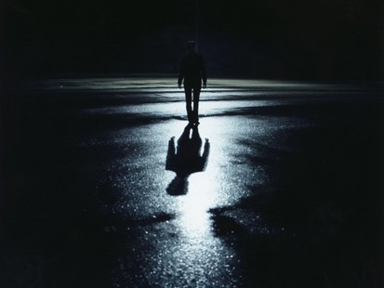
The Great Transfer
"For he has rescued us from the kingdom of darkness
and transferred us into the Kingdom of his dear Son
¹⁴ who purchased our freedom and forgave our sins" (Col. 1:13-14)

Slide 39
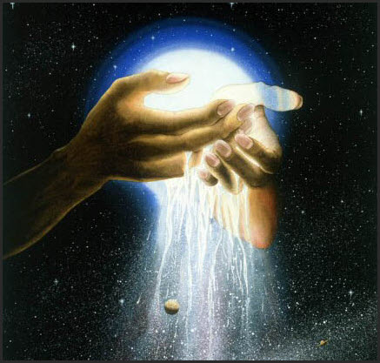
Colossians 1:15
"Christ is the visible image of the invisible God. He existed before anything was created and is supreme over all creation."
Colossians 1:15 (NLT)

Slide 40
Colossians 1:16-18
"For by Him all things were created: things in heaven and on earth, visible and invisible, whether thrones or powers or rulers or authorities; all things were created by Him and for Him. He is before all things, and in Him all things hold together. And He is the head of the body, the church; He is the beginning and the firstborn from the dead, so that in everything He might have the supremacy."
Colossians 1:16-18 (NIV)

Slide 41
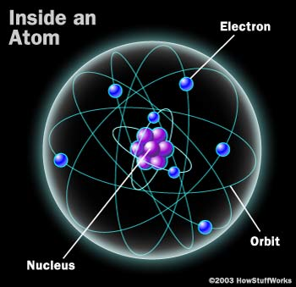
Inside an Atom
Electron (negative)
"…in Him all things hold together" (2:17)
Orbit
Proton Nucleus (positive)
Notes:
“Electric charge is the physical property of matter that causes it to experience a force when placed in an electromagnetic field. There are two types of electric charges: positive and negative.” (wikipedia on “electric charge”).
One of the basic laws of physics is that opposite charges attract one another. So how does the negatively-charged electron continue to circle around the positively-charged nucleus? Why doesn’t the electron just fly into the nucleus? Verse 17 says, “In [Christ] all things hold together.”
Another law says that like charges repel one another. Good enough, but why doesn’t this apply in each atom? Why don’t all these positively-charged protons repel one another and fly into space? Verse 17 says, “In [Christ] all things hold together.”

Slide 42
¹⁹ For God in all his fullness was pleased to live in Christ, ²⁰ and through him God reconciled everything to himself. He made peace with everything in heaven and on earth by means of Christ’s blood on the cross.
Col 1:19-20 (NLT)

Slide 43
Hebrews 1:1-2 NLT
"Long ago God spoke many times and in many ways to our ancestors through the prophets. ²And now in these final days, he has spoken to us through his Son. God promised everything to the Son as an inheritance, and through the Son he created the universe."
Notes:
Long ago God spoke many times and in many ways to our ancestors through the prophets. ² And now in these final days, he has spoken to us through his Son. God promised everything to the Son as an inheritance, and through the Son he created the universe. ³ The Son radiates God's own glory and expresses the very character of God, and he sustains everything by the mighty power of his command. When he had cleansed us from our sins, he sat down in the place of honor at the right hand of the majestic God in heaven. ⁴ This shows that the Son is far greater than the angels, just as the name God gave him is greater than their names.

Slide 44
John 1:3
JOHN: SUMMING UP THE MESSAGE
CHAPTER 1: 6 GREAT TRUTHS OF
JESUS CHRIST!
VERSE 1: The Pre-existent One
A Distinct Person
He Was and IS God
VERSE 2: Eternally Co-existent
"Through him all things were made; without him nothing was made that has been made."
VERSE 3: Creator of the Universe
25
1
Notes:
Verse 3: He is the Creator of the Universe…
//// "Through him all things were made; without him nothing was made that has been made."

Slide 45
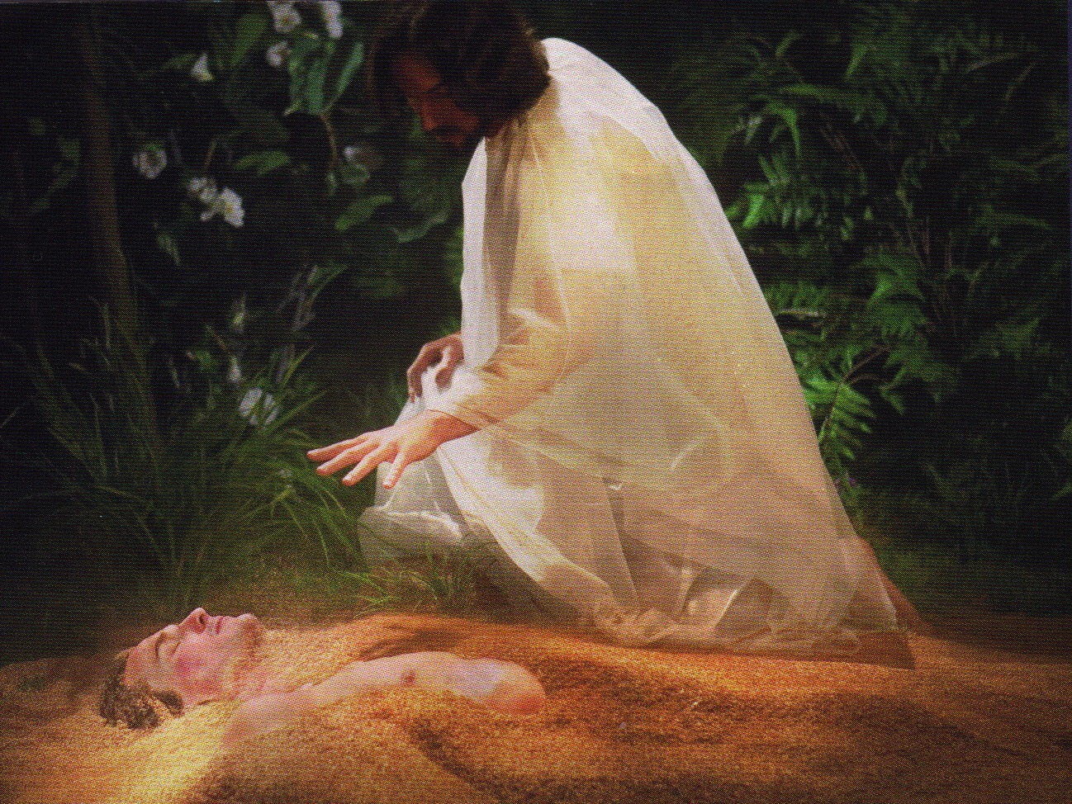
Jesus formed Adam from the dust (John 1:3; Gen. 2:7).

Slide 46
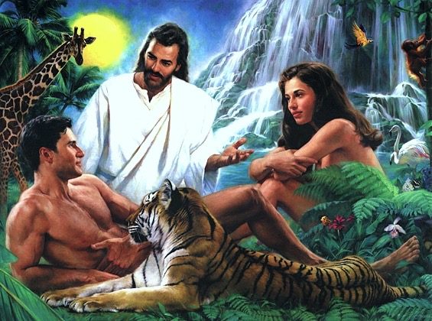
Jesus Created Adam and Eve (John 1:3; Gen. 2:21-23)

Slide 47
True Jesus Church, Adam Road
195
200
“Jesus is the heavenly Father” !! ??
= Modalism

Slide 48
What Does the True Jesus Church Believe?
Identification with TJC
200
+
Baptism in TJC (Head Bowed)
+
Footwashing by TJC Minister
+
Communion (Transubstantiation)
+
Reception of the Holy Spirit
+
Speaking in Tongues
+
(Faith in Christ? No!)
=
Salvation ! ? ! ?

Slide 49
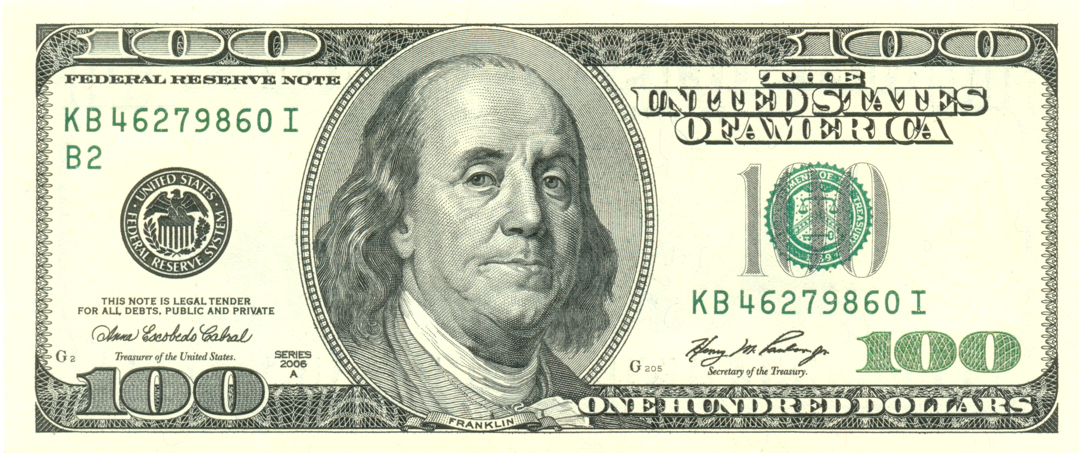
Counterfeit?

Slide 50
Slides on Colossians 2

Slide 51
What’s Wrong?
“Gnosticism” is wrong since deity is in Christ (2:6-10).
Legalism is wrong since reality is in Christ (2:11-17).
Mysticism is wrong since headship is in Christ (2:18-19).
Asceticism is wrong since immunity is in Christ (2:20-23).
Notes:
Here in verses 5-11 Paul exhorted the Christians at Colossae to "put to death their sinful ways".
"So put to death the sinful, earthly things lurking within you…" (NLT) parallels with what Jesus commanded in Matthew 18:9, "And if your eye causes you to sin, gouge it out and throw it away…" (NLT). Neither Christ's nor Paul's injunction can mean hack, hew or maim the limbs and organs of the body. The whole idea of putting to death or gouge out the eye means "doing away with what is evil" in us.
And what are these sinful earthly things - the evil things in us?

Slide 52
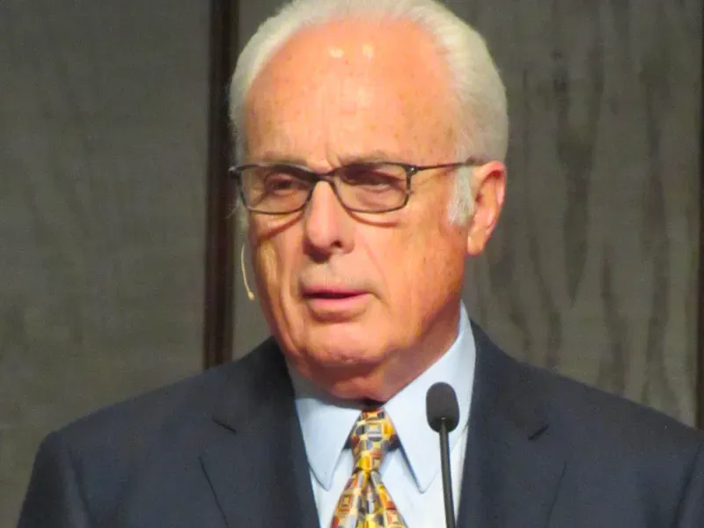
False Teaching
The first symptom of false teachers is what they affirm. A false teacher "advocates a different doctrine." False teaching may take many forms. It may deny God's existence, or teach error about His nature and attributes. It may deny the Trinity. Error about Christ's Person and work is also common in false systems. Those who deny His virgin birth, sinless perfection, substitutionary death, bodily resurrection, or future return show signs of a dangerous infection. False teachers also teach error about the nature, Person, and work of the Holy Spirit. Yet another strain of the disease of false teaching denies the authenticity, inspiration, authority, or inerrancy of Scripture.
John MacArthur
The Pathology of False Teachers

Slide 53
How can you be protected from false teaching?
Notes:
What ways can we prevent heretical ideas from capturing us in their snare?

Slide 54
I. Believe that Jesus is God (Col 1–2).
Father
is
is not
is not
GOD
is
is
Son
Spirit
is not
How to be protected from false teaching
Notes:
Guard yourself from heresy by embracing the deity and supremacy of Christ over all things.

Slide 55
II. Embrace holy living (Col 3–4).
How to be protected from false teaching
Notes:
Protect yourself from heresy by your pure lifestyle.

Slide 56
Slides on Colossians 3

Slide 57
¹ Since, then, you have been raised with Christ, set your hearts on things above, where Christ is, seated at the right hand of God.
² Set your minds on things above, not on earthly things.
Col 3:1-2 (NLT)

Slide 58
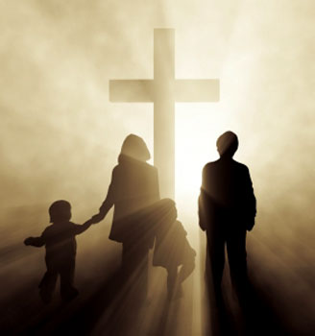
Holy living is relational.

Slide 59
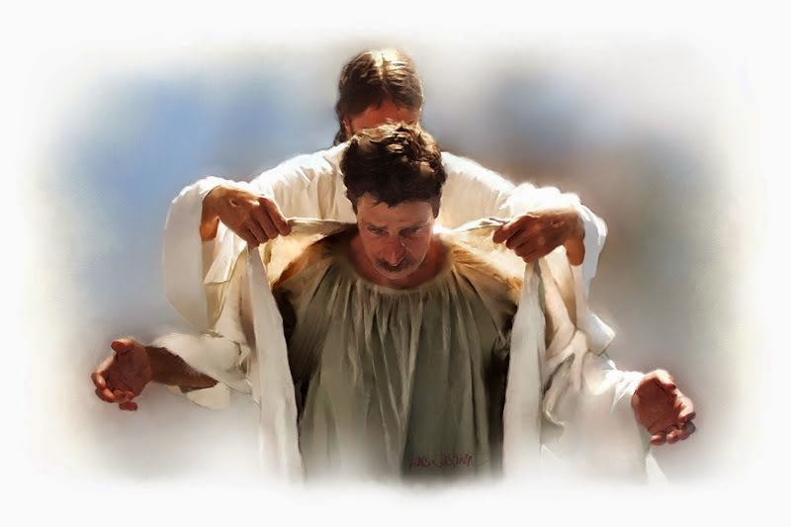
How Can We Put on the Virtues of a New Life? Colossians 3:5-17
Notes:
I will put off the shabby clothes….

Slide 60
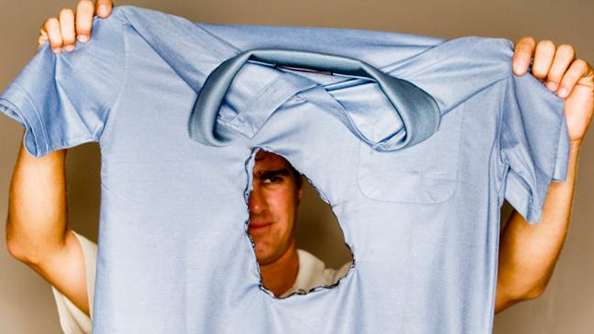
1. Put off the old clothes (3:5-11).
Notes:
Here in verses 5-11 Paul exhorted the Christians at Colossae to "put to death their sinful ways".

Slide 61
Col. 3:5 "So put to death the sinful, earthly things lurking within you" (NLT). Matthew 18:9a "And if your eye causes you to sin, gouge it out and throw it away" (NLT).
Notes:
Here in verses 5-11 Paul exhorted the Christians at Colossae to "put to death their sinful ways".
"So put to death the sinful, earthly things lurking within you…" (NLT) parallels with what Jesus commanded in Matthew 18:9, "And if your eye causes you to sin, gouge it out and throw it away…" (NLT). Neither Christ's nor Paul's injunction can mean hack, hew or maim the limbs and organs of the body. The whole idea of putting to death or gouge out the eye means "doing away with what is evil" in us.
And what are these sinful earthly things - the evil things in us?

Slide 62
The point – "Do away with what is evil in us"
Notes:
Here in verses 5-11 Paul exhorted the Christians at Colossae to "put to death their sinful ways".
"So put to death the sinful, earthly things lurking within you…" (NLT) parallels with what Jesus commanded in Matthew 18:9, "And if your eye causes you to sin, gouge it out and throw it away…" (NLT). Neither Christ's nor Paul's injunction can mean hack, hew or maim the limbs and organs of the body. The whole idea of putting to death or gouge out the eye means "doing away with what is evil" in us.
And what are these sinful earthly things - the evil things in us?

Slide 63
Put off the clothes of corrupt living (3:5-7)
Notes:
I am sure we are all no stranger to this particular word. I have not been to many countries like most of you but coming from a country like India where corruption is quite prevalent.

Slide 64
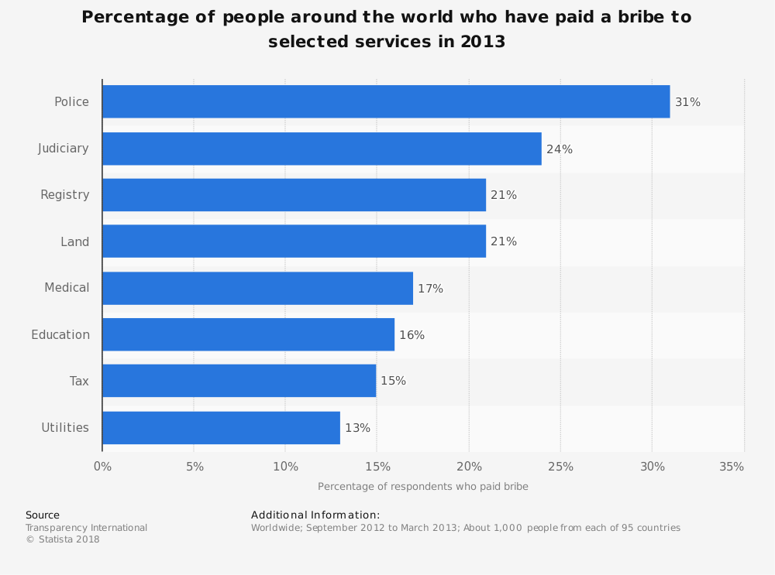
Death to corrupt living (3:5-7)
Percentage of people around the world who paid a bribe to selected services in 2013
Police
Judiciary
Registry
Land
Medical
Education
Tax
Utilities

Slide 65
Death to corrupt living
Notes:
In my [Athan’s] home country of India, to get a job in govt. sector we need to pay heavy bribes to the conducting officers.
In 2012, one of my younger brothers went for an army recruitment… physical fitness passed…written passed…medical exam passed… but was rejected because we were unable to pay the bribe around S$4000.
It broke my brother's heart and brought frustration… your corrupt living has an adverse impact not just to you alone but to other people, especially those who are poor.

Slide 66
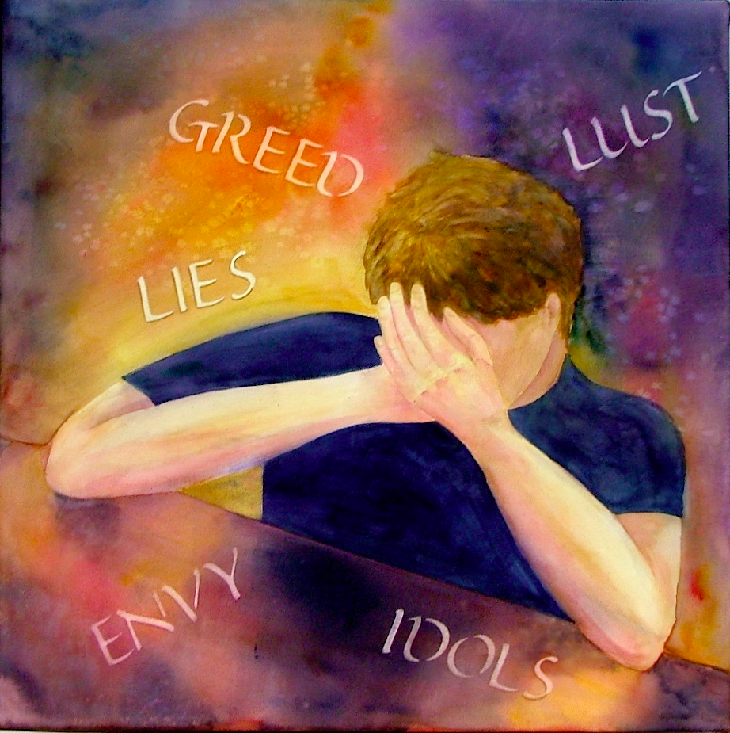
"Have nothing to do with sexual immorality, impurity, lust, and evil desires. Don't be greedy, for a greedy person is an idolater, worshiping the things of this world" (3:5b NLT)
Notes:
Corrupt living is not just the corruption in financial matters. Paul listed a whole range of habits that tags along with corrupt living. They are sexual immorality, impurity, lust, and evil desires and greed.
We need to put away our impure thoughts – thoughts such as desiring or scheming to harm people. We also need to put away sexual impurity. Singles, we no longer care what we did in the past because of our new identity as new people in Christ but from this point forth let us be sexually pure. Married people, as people of God, God demands you to be sexually faithful to your spouses. Evils such as these, and on which the apostle says God's wrath rests, must be slain.

Slide 67
Put off the clothes of wrong conversation (3:8-9)
Notes:
Paul deals with the sins of speech which seemed, like echoes of the past, to linger on the lips of the Colossians. Proverbs 18:21 says "The tongue can bring death or life; those who love to talk will reap the consequences (NLT)". James says "And the tongue is a flame of fire. It is a whole world of wickedness, corrupting your entire body. It can set your whole life on fire, for it is set on fire by hell itself (Jam 3:6-7 NLT). Jesus Christ said "You brood of snakes! How could evil men like you speak what is good and right? For whatever is in your heart determines what you say. (Mat 12:34 NLT)". Yes we should do away with wrong conversations.

Slide 68
3:8-9
"But now is the time to get rid of anger, rage, malicious behavior, slander, and dirty language. Don't lie to each other, for you have stripped off your old sinful nature and all its wicked deeds"
(3:8-9 NLT)
Notes:
Paul deals with the sins of speech which seemed, like echoes of the past, to linger on the lips of the Colossians. Proverbs 18:21 says "The tongue can bring death or life; those who love to talk will reap the consequences (NLT)". Jesus Christ said "You brood of snakes! How could evil men like you speak what is good and right? For whatever is in your heart determines what you say. (Mat 12:34 NLT)". Yes we should do away with wrong conversations.

Slide 69
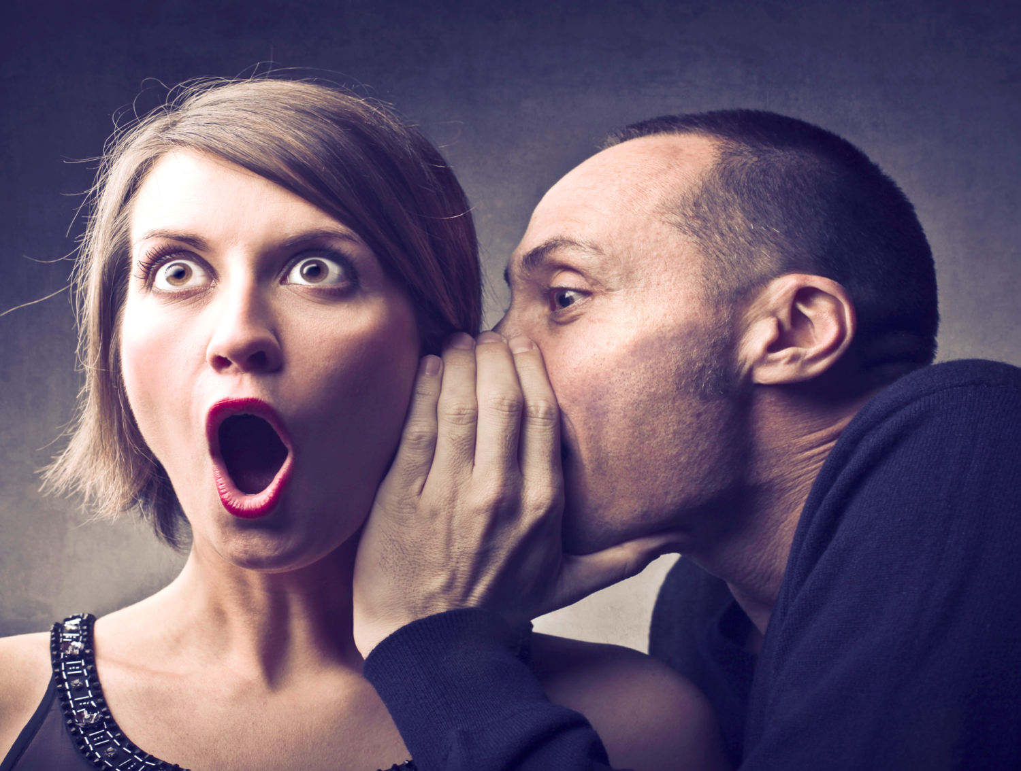
What speech should be put away?
Anger, Rage, Malice, Slander, Dirty Language, Falsehood…
Notes:
Do away with conversations that can cause someone to
1) "Anger," and sin
2) Conversations that will "Enrage"
3) Talks to malign someone's image;
4) "Slander," i.e. blasphemy;
5) "Dirty language," i.e. abusive words;
6) "Falsehood," a word that needs no description. Let us not speak pretentiously but true to our words.

Slide 70
Death to Conventional Distinctions
Notes:
Paul exhorted the Colossians that as new people who have put on the virtues of new life, they must also put to death the conventional distinctions which leads to divisions in the church. For we are all made new in Christ and in Christ there is no distinction between "…a Jew or a Gentile, circumcised or uncircumcised, barbaric, uncivilized, slave, or free. Christ is all that matters, and he lives in all of us (Col 3:11 NLT)".

Slide 71
3:10-11
"In this new life, it doesn't matter if you are a Jew or a Gentile, circumcised or uncircumcised, barbaric, uncivilized, slave, or free. Christ is all that matters, and he lives in all of us" (3:10-11 NLT).
Notes:
If Christ have made us all one in him, shall we still continue live our life dividing among ourselves? No, I am American and I cannot be with the Indian; I am Indians and I cannot be with the Chinese, Dutch, Pilipino…

Slide 72
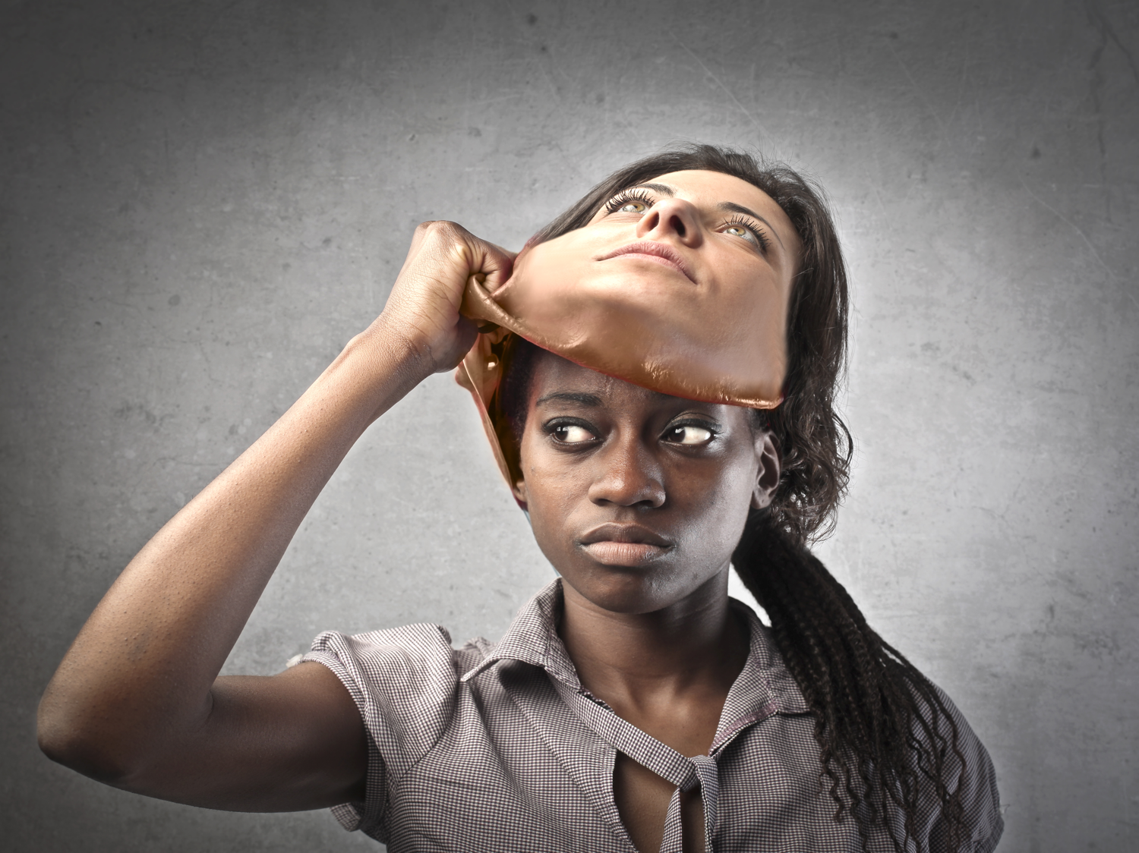
Avoid these distinctions…
Ethnic: "Greek and Jew"
Ceremonial: "circumcision or uncircumcision"
Cultural: "barbarian, uncivilized"
Social: "slave and free"
Notes:
1) Ethnic distinctions: "Greek and Jew". Let us stop drawing boundaries along the line of our ethnic groups.
2) Ceremonial: "circumcision or un-circumcision". The Jewish Christians emphasized so much on ritual purity and that is one of the main contention among the believers in early church. Let us put away that "my denomination is better than yours!" but rather practice what the Bible teach us.
3) Distinctions of culture: "barbarian, uncivilized". Unable to appreciate different culture is often the many causes of conflicts. In India, almost every week we have a report of the people from northeastern India and the mainlanders having clashes because we cannot accept and appreciate our culture.
4) Social: "slave and free." Here the word slave seems to have special reference here to the runaway slave (Onesimus) who was going to carry to his master the apostle's letter, and who was to be received as a brother both of Philemon and Paul. But the point Paul wants to underscore is that there is no longer hierarchical systems in our new identity with Christ.

Slide 73
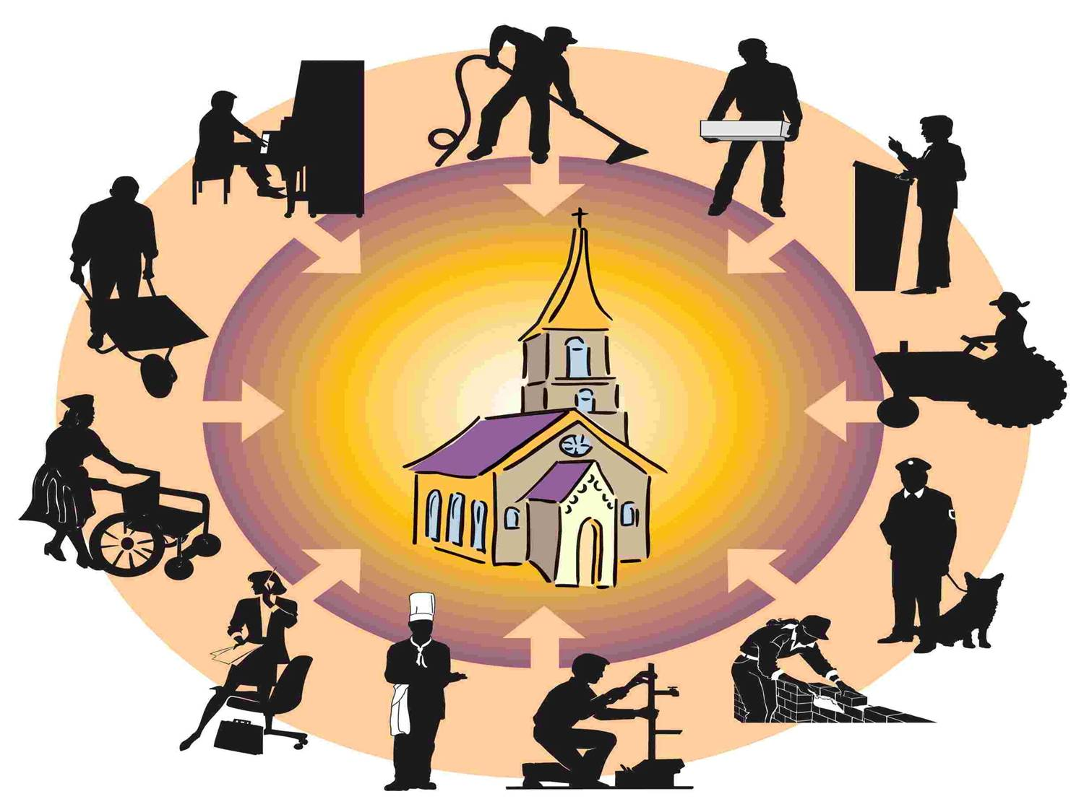
The church embraces all
Notes:
I am glad that here at CIC… I learnt to realize that I need to come down.

Slide 74
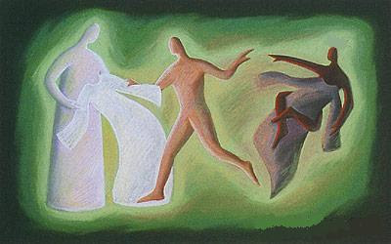
2. Put on the grace of Christ (3:12-17).
Notes:
Let us put away our old sinful habits – things which Christ has already taken it off from us by his death so that we may put on the new dress of grace. Through Christ's death we now have the power the put off our old sinful habits. We can now make a choice to put to death our bad habits – the old man or to let it rule over us and prevent us from living a free life in Christ. Christ has put to death our sinful habits, he have taken away our sinful clothes, lets us not go back to those old ways again but put on the virtues of new life and live as new people made alive in Christ.
What are these grace of Christ that we are to put on as his new people made alive in him?

Slide 75
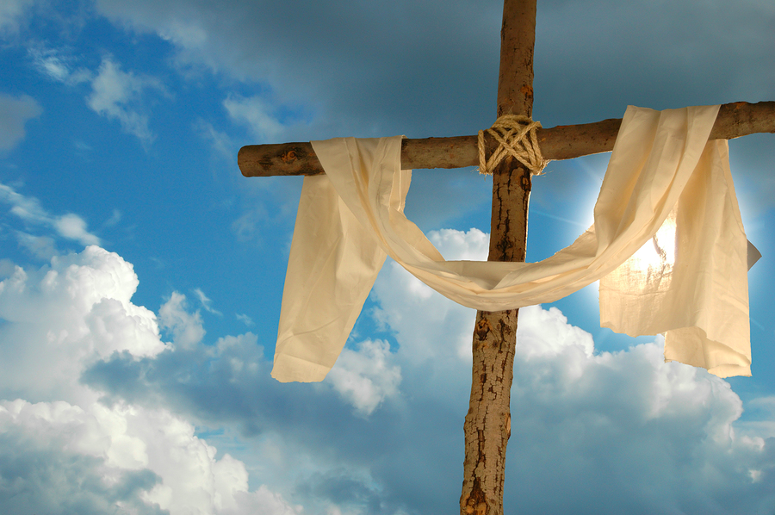
The clothes of compassion (3:12)
Notes:
Put on... compassion. “Since God chose you to be the holy people he loves, you must clothe yourselves with tenderhearted mercy, kindness, humility, gentleness, and patience” (3:12 NLT).
When we are clothed with compassion, we show kindness, humility, gentleness and patience for one another. In the gospel accounts, we know that when Jesus saw the crowds he was filed with compassion (Matt. 9:36; Mk. 6:34). Again in the Gospel of Mark when Jesus saw a leper asking him to heal him of his leprosy, Jesus was moved with compassion and he healed. Elsewhere in the Bible, Exod 34:6; 2 Chron 30:9; Neh 9:17, 31; Pss 85:15; Joel 2:13; and Jn 4:2, this compas-sion is described as grace of God. Paul in Philippians 1:8 says that he love the Philippians and long for them "…with the tender compassion of Christ Jesus (NLT)". This is the compassion that we are talking about. Through Jesus Christ, God has given us this dress – this compassion which we must wear it as new people in Christ.

Slide 76
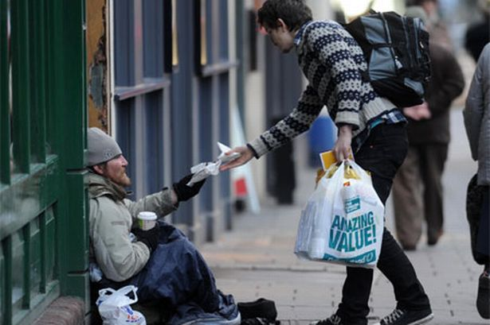
Without compassion, we cannot feel for others.
Notes:
When we are clothed with compassion, we can show kindness, humility, gentleness and patience to one another. In the gospel accounts, we know that when Jesus saw the crowds he was filed with compassion (Matt. 9:36; Mk. 6:34). Again in the Gospel of Mark when Jesus saw a leper asking him to heal him of his leprosy, Jesus was moved with compassion and he healed.
Without compassion, we cannot feel for others. We cannot truly, from our hearts say that I care for you. In order to be able to care for one another we need to be clothed with the grace of compassion.

Slide 77
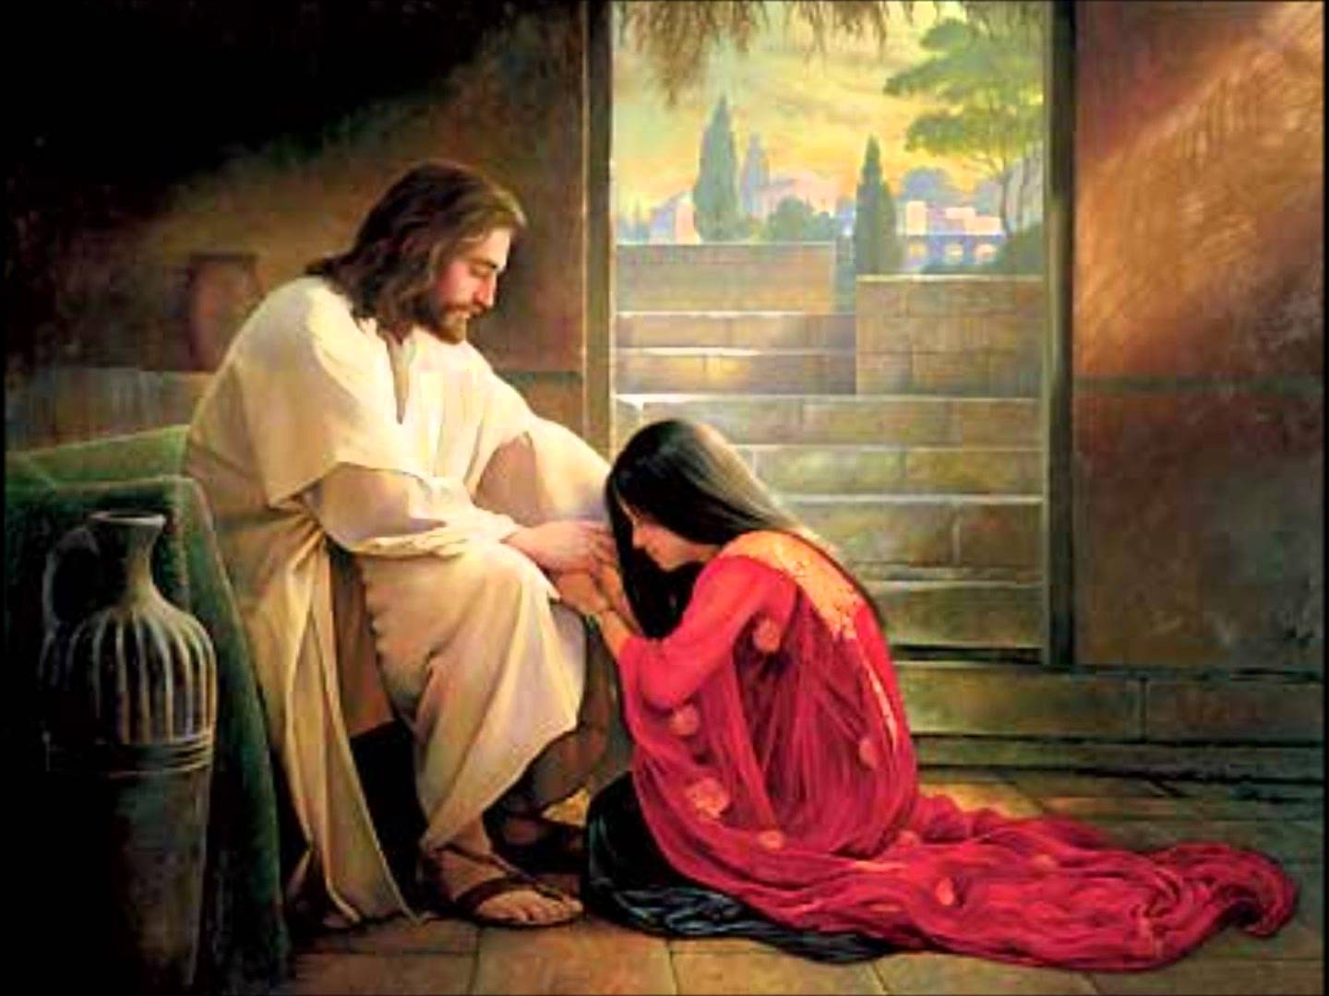
The clothes of forgiveness (3:13)
Notes:
Paul again exhort the Colossians to put on the clothes of forgiveness. “Make allowance for each other’s faults, and forgive anyone who offends you. Remember, the Lord forgave you, so you must forgive others” (3:13 NLT).
He exhorted them that they must forgive one another just as they have received forgiveness for God through Christ. The same applies for us today. We were once in a wretched state of sin. Every time we lived offending God by our thoughts, action and speech. But God forgave us and made us his children. Ephesians 4:32 clearly says that we must forgive one another just as Christ has forgiven us.

Slide 78
"Forgiveness is not giving someone what they deserve but what they need" – Anonymous "The weak can never forgive. Forgiveness is the attribute of the strong” – Gandhi
Notes:
As we claim to have put to death through our union with Christ and have put on the grace of Christ – the forgiveness, I would like you to think about someone who have hurt you beyond words; whom you find it hard to forgive. And ask yourselves, 'is it really to hard for me?'.

Slide 79
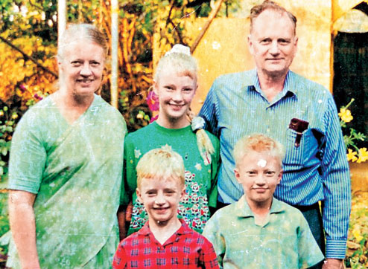
Graham & Gladys Staines
Notes:
Perhaps, the greatest story of forgiveness comes from the life of the widowed lady Gladys Staines.

Slide 80
3:13
"Make allowance for each other's faults, and forgive anyone who offends you. Remember, the Lord forgave you, so you must forgive others" (Col. 3:13 NLT)
Notes:
Without forgiveness, there cannot be a very strong relationship. Forgiveness is the clue that binds marriage, friendship and our relationship with one another.
Sometimes, it just you that you need to forgive yourself. We cannot forgive other unless we forgive ourselves of our past foolish mistakes. At one point of time, it was very difficult for me to forgive people who have provoked me and hurt my feelings beyond words. I took revenge for every single offense they made to me. When I was young, if any of relatives scold me for good or wrong reasons, I cannot challenge them so what I did… I killed their chickens, pets… sometimes, I used to take catapult and shoot them from afar… but God worked in my and as I receive Christ, I slowly learned to forgive. It will be ungrateful on our parts if we don't forgive one another because we have received forgiveness from God.
Let us put on the clothe of forgiveness.

Slide 81
The clothes of love (3:14)
Notes:
“Above all, clothe yourselves with love, which binds us all together in perfect harmony” (3:14 NLT).
As we put on the grace clothe of compassion, forgiveness, let us complete it by putting on the clothes of love. Paul said here that it is love that binds everything. Perhaps his best teaching about love is recorded in 1 Corinthians 13. 1 John 4:8 says God is love. As his children, let us also love one another. Let us adorn ourselves with love because love expresses the willingness of the person to give himself to the good of others.

Slide 82
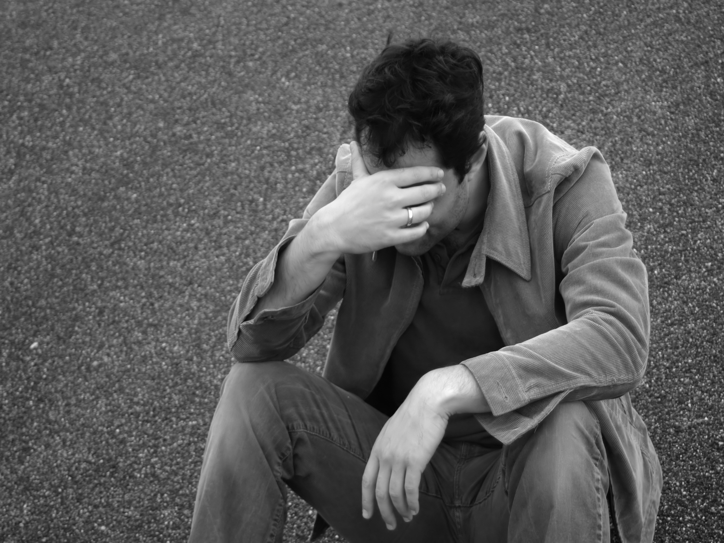
Forgiven but I cannot…
Notes:
Forgiven but I cannot love this man… This is a litmus test for us as Christians. We can forgive but choose not to love. If we truly forgive someone why can't we love? If you have some conflicts with your spouses, parents, friends, room mates in the past or recently, and if you say you have forgiven them but still cannot love, take this as God speaking to you today and accept it as a challenge to love that person.

Slide 83
1. Put off the old clothes 2. Put on the grace of Christ
Notes:
We are given the grace to live our life as victors in Christ. God in his grace have set us free by
Put off the old clothes by making us die to the sins of a. corrupt living b. wrong conversation c. conventional distinctions, and by enabling us to
Put on the grace of Christ a. compassion
b. forgiveness
c. love
Now let us go back to the questions we asked in the beginning:

Slide 84
Anger?
Hatred?
Broken
Relationship?
Thoughts of Disdain?
Painful Past?
Greed?
Jealousy?
Notes:
We have been given the grace to live our life as new people in Christ. As new people we are to adorn ourselves with the virtues – the dress of new life. If we don't put on or cloth our body with clothes, then we all know we will be naked. If we are naked, we are susceptible to heat, cold, insect bites and vulnerable to hosts of dangers.
If you don't put off the grave clothes and put on the new virtues of life – i.e the grace of Christ, then we are naked Christians – naked and exposed to hosts of sins lurking around us. We will be tempted to anger and commit sin, we will want to hate people, we will be haunted by our painful past experience, we will go back to sexually immoral lives.
Are there any grave clothes on you that you need to remove? Think about this.

Slide 85
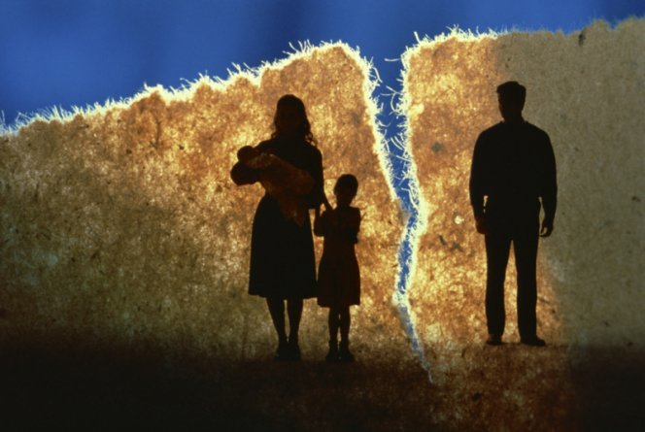
What if we followed Colossians 3:18-19?
"Wives, submit to your husbands, as is fitting for those who belong to the Lord.
¹⁸Husbands, love your wives and never treat them harshly” (Col. 3:18-19 NLT)

Slide 86
Ephesians & Colossians
Characteristics
189-190
Ephesians
Colossians
Similar passages
Similar passages
1:15-17
1:3-4
1:18
1:27
1:19-20
2:12
1:21-23
1:16-19
5:22-24 (wives)
3:18 (wives)
5:25-33 (husbands)
3:19 (husbands)
6:1-3 (children)
3:20 (children)
6:4 (fathers)
3:21 (fathers)
6:5-8 (slaves)
3:22-25 (slaves)
6:9 (masters)
4:1 (masters)

Slide 87
Slides on Colossians 4

Slide 88
How can you be protected from false teaching?
Notes:
What ways can we prevent heretical ideas from capturing us in their snare?

Slide 89
Main Idea of Colossians
Protect yourself from false teaching by embracing both Christ’s deity and a holy life.

Slide 90
OUTLINE OF COLOSSIANS
THEOLOGY
PRACTICE
TO

Slide 91
I. Believe that Jesus is God (Col 1–2).
Father
is
is not
is not
GOD
is
is
Son
Spirit
is not
How to be protected from false teaching
Notes:
Guard yourself from heresy by embracing the deity and supremacy of Christ over all things.

Slide 92
II. Embrace holy living (Col 3–4).
How to be protected from false teaching
Notes:
Protect yourself from heresy by your pure lifestyle.

Slide 93
WHAT TO EMBRACE
DEITY
HOLINESS
TO

Slide 94
What old “clothes” do you need to toss?
Notes:
Here in verses 5-11 Paul exhorted the Christians at Colossae to "put to death their sinful ways".

Slide 95
Occasion
188-189
Asia Minor was the seedbed for what developed into 2nd century Gnosticism. Paul's counterattack tells us this about the heresy:
1. Jewish—legalism of following OT laws and ceremonies (2:16-17)
2. Greek philosophy—followed a so-called "deeper knowledge" revealed only to a special "elite" (2:2b-4, 8-10)
3. Worshipped angels as mediators between man and God (2:18)
4. Denied Christ's deity (1:15; 2:9), & thus His supremacy (1:15b, 17a) & ability to create (1:16) & sustain the world (1:17)
5. Ascetic nature had a low view of the body (2:20-23)
What was the Colossian heresy? The above shows it was a syncretistic Jewish-Greek-Ascetic-Pagan cult. Paul's method to fight the heresy is to emphasize the deity & supremacy of Christ.

Slide 96
What new “clothes” do you need to put on?
Notes:
I will put off the shabby clothes….

Slide 97
Black

Slide 98
Bible Exposition • BibleStudyDownloads.org
Get this presentation and script for free!

